Slide 1

Hydration and Exercise considerations
By Danny Fagan B.Sc. CSCS, CPT, BACPR.

Slide 2
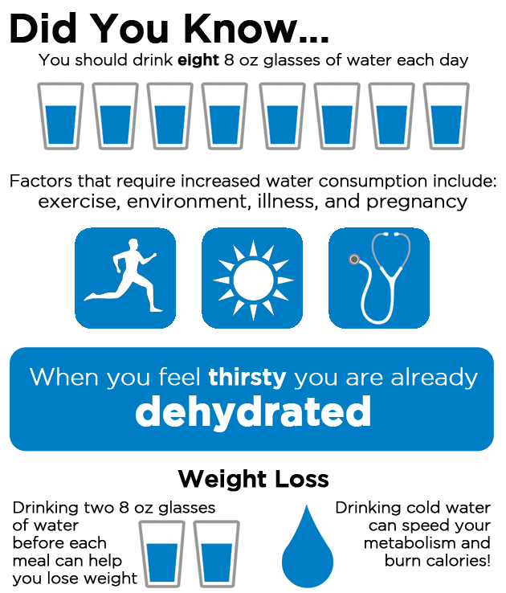

Slide 3
Water in the Body
Transporting: Nutrients, O2, Waste CO2, Messages to Hormones.
Dissolver: Excellent solvent (Not lipids)
Cleaner: Water flushes kidneys and liver removing toxins
Lubricating: Joints, Digestive system & Breathing
Padding; Shock absorber
Regulation: Temperature (sweating)
Water in blood vessels near the skin.
Reactor: Chemical reactors needed for normal metabolic processes.

Slide 4
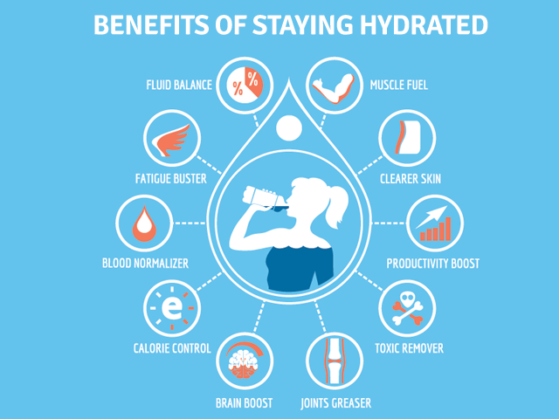
X

Slide 5
How Much for you ???
A good base goal (whether you're working out or not) is to divide your bodyweight (in lbs) in half and drink that number of ounces of water every 24 hours. 1 oz = 29.5ml
EXAMPLE: Dan.
Weight = 168 lbs
Weight X 0.5 = 84 oz’s =
84 oz x 29.5ml = 2478ml
On the guidance of 2L per day I would be 478ml / day short.

Slide 6
How much while Exercising?
60 minutes of Moderate to Vigorous exercise = Add 500ml
Greater than 60 mins MVPA = 125ml / 15min + Electrolytes
Drink BEFORE and AFTER but minimal During….
500ml < 2 hrs BEFORE
200-300ml During
Slowly rehydrate AFTER Exercise

Slide 7
Hydration in Hot Weather
700-1000 ml per hour when Physically Active in Hot Weather
Pre hydration before coming into hot weather
Understand the signs and symptoms of early dehydration.
Try to avoid direct sunlight and wear sun hat and blocker to protect the skin.
Take regular rest / water breaks every 15 mins

Slide 8
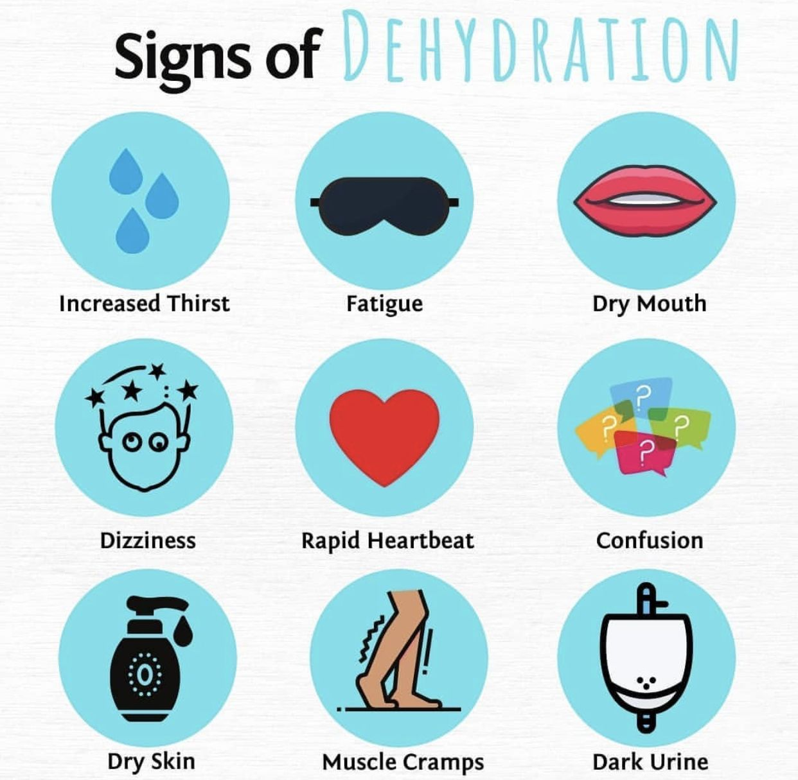

Slide 9
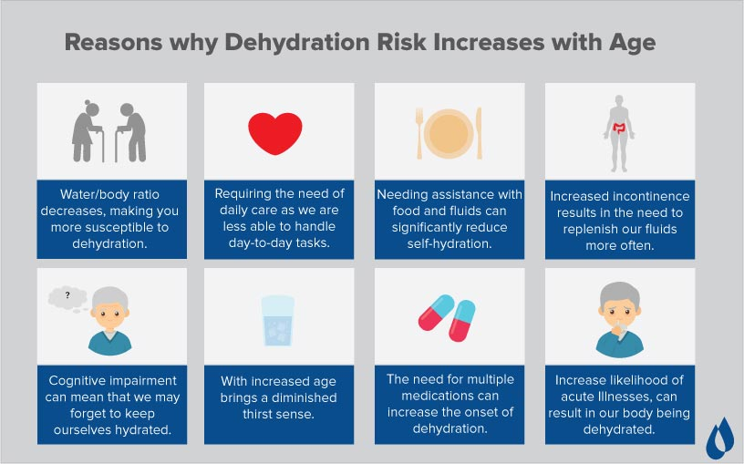

Slide 10
The best & worst Hydration Types
Milk. ...
Coconut Water. ...
Cucumber Juice. ...
Herbal Teas. ...
Aloe Water Or Aloe Vera Juice. ...
Fruit Infused Water. ...
Chia Water.
Soda (Carbonated drinks)
Beer
Wine / Liquer
Smoothies
Hot choc
Coffee
Lemonade
Energy Drinks

Slide 11
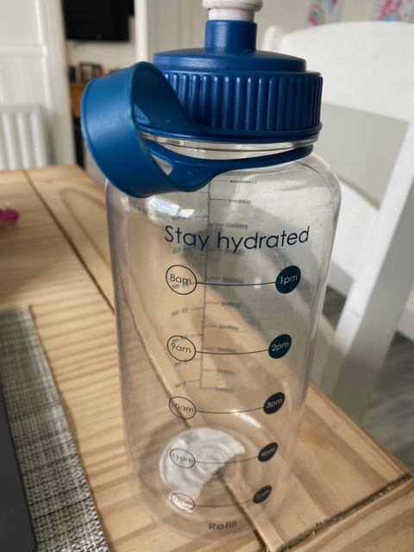
The Key Take Home
Pre-hydrate
Know how much you need
Drink more in the sun
Don’t wait until thirsty
Drink more when PA
Know the signs of DH
Know the good and bad drinks

